Slide 1
MUS 223 • Literature and Materials of Music II
Now playing: “Livery Stable Blues,” Original Dixieland Jass Band (1917)
Today (Monday, May 4, 2026): Jazz Basics
Melody
Old Scales
A New Scale: The Blues Scale
Rhythm
Swing
Syncopation
Harmony
Extensions
Chord Symbols
To do for next time:
Homework #5 is due next Monday.

Slide 2
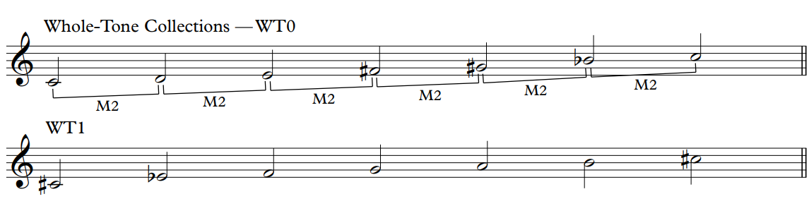
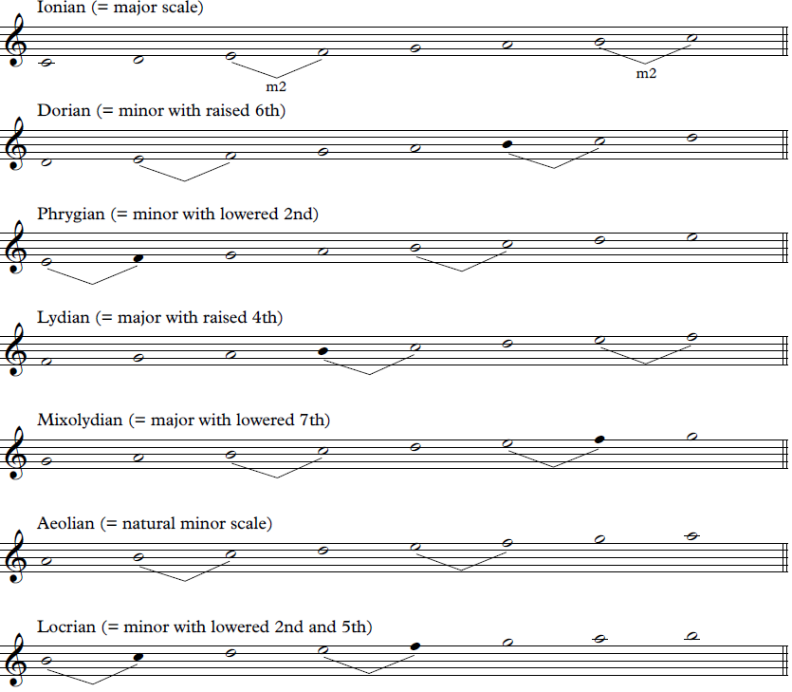
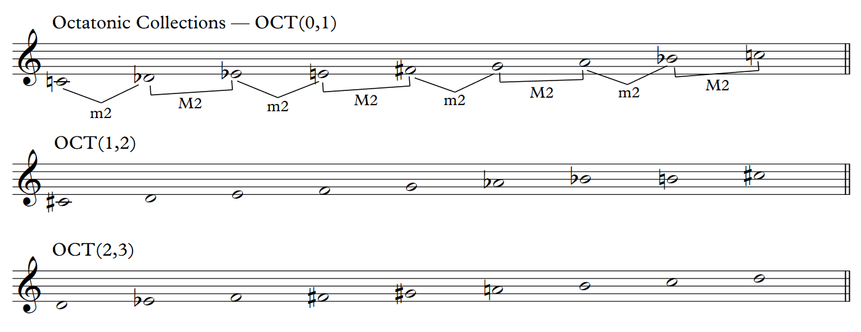
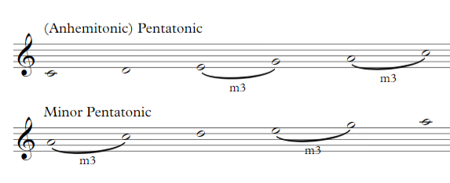
Old Scales

Slide 3
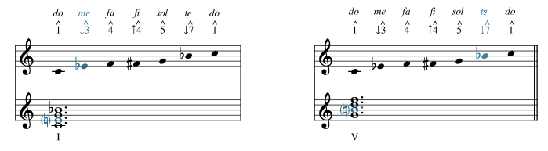
New Scale[s]: The Blues Scale
The blues scale is like a minor pentatonic scale with an additional chromatic passing tone:
do–me–fa–fi–sol–te (1^−↓3^−4^−↑4^−5^−↓7^)
It’s a useful scale for beginning improvisers to base their melodies on. It works for both tonic and dominant harmonies in many blues and jazz contexts.

Slide 4
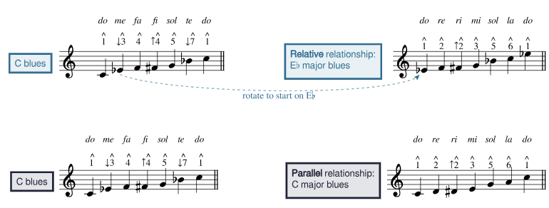
New Scale[s]: The Blues Scale
The difference between a major and minor pentatonic scale is identical to the difference between the major and minor blues scale: the major blues scale is a rotation of the blues scale of its relative minor. Begin the blues scale on me, and you will get a blues scale for the relative major.

Slide 5
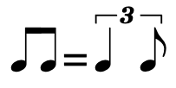
Rhythm: Swing
Swing eighths are notated as regular straight eighths but performed unevenly, in a quasi-triplet* rhythm where the first note is twice as long as the second.
WHY not just use triplets? Why use eighths?
> See Notes inégales - Wikipedia
* The exact ratio of swing eighths varies from piece to piece and from performer to performer.
Faster tempos tend to be more straight and slower tempos tend to employ a more dramatic swing.
Compare the swing of “Eternal Triangle” by Dizzy Gillespie and “Duet” by Count Basie—the former has a more even swing rhythm, while the latter has a more uneven swing.

Slide 6
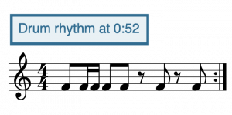
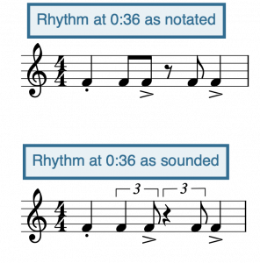
Rhythm: Swing
Swing eighths are notated as regular straight eighths but performed unevenly, in a quasi-triplet rhythm where the first note is twice as long as the second.
Cole Porter’s “Anything Goes”

Slide 7

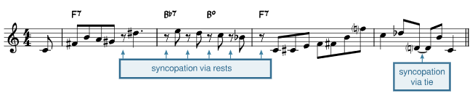
Rhythm: Backbeat & Syncopation
Jazz will also feature a backbeat.
An accent on beats 2 & 4
…and syncopation.

Slide 8
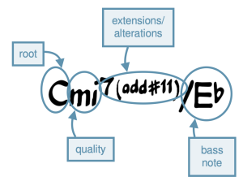
Harmony: Chord Symbols

Slide 9
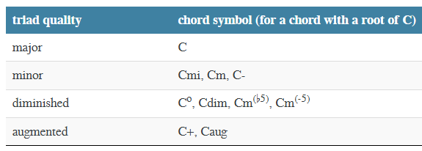
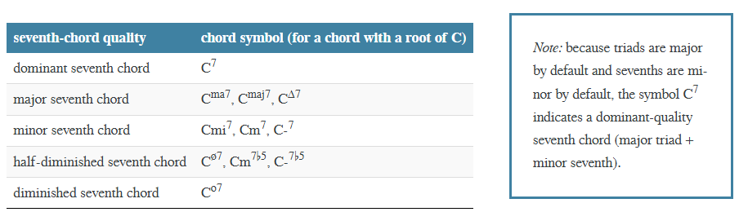
Harmony: Chord Symbols

Slide 10
Harmony: Chord Symbols
Extensions: “Adding additional thirds on top of the triad. Most commonly refers to ninths, elevenths, or thirteenths rather than sevenths, although sevenths are also extensions.”
Quality & Alterations: Assume default intervals for extensions:
Will use # and b to raise or lower regardless of actual accidentals.
Added Note & Suspensions: If no seventh or extensions are implied but notes beyond the triad are present. (add 6, add 9)
Sus 2, sus 4 are common. Assume sus 4 if all you see is “sus”.
m7 | M9 | P11 | M13

Slide 11
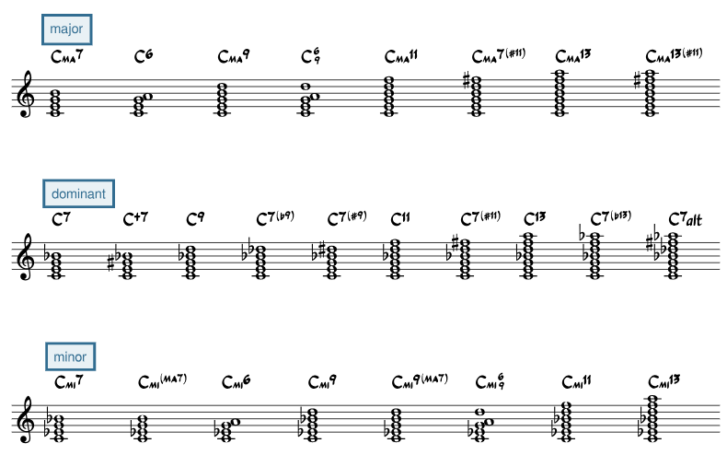
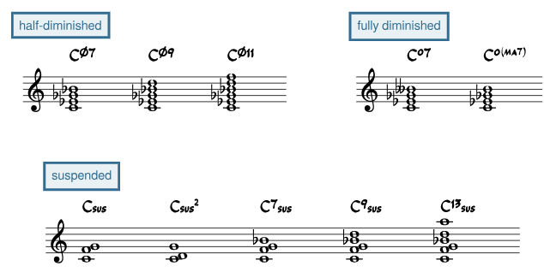
Harmony: Chord Symbols

Slide 12
MUS 223 • Literature and Materials of Music II
Now playing: “Livery Stable Blues,” Original Dixieland Jass Band (1917)
Today (Wednesday, May 6, 2026): Jazz Basics
Warm-up
Harmony
Extensions
Chord Symbols
Voicing
To do for next time:
Homework #5 is due next Monday.

Slide 13
Warm-up
Write a B minor pentatonic scale.
Write a B [minor] blues scale.
Write a D major blues scale.

Slide 14
Warm-up
Write a B minor pentatonic scale.
Write a B [minor] blues scale.
Write a D major blues scale.

Slide 15
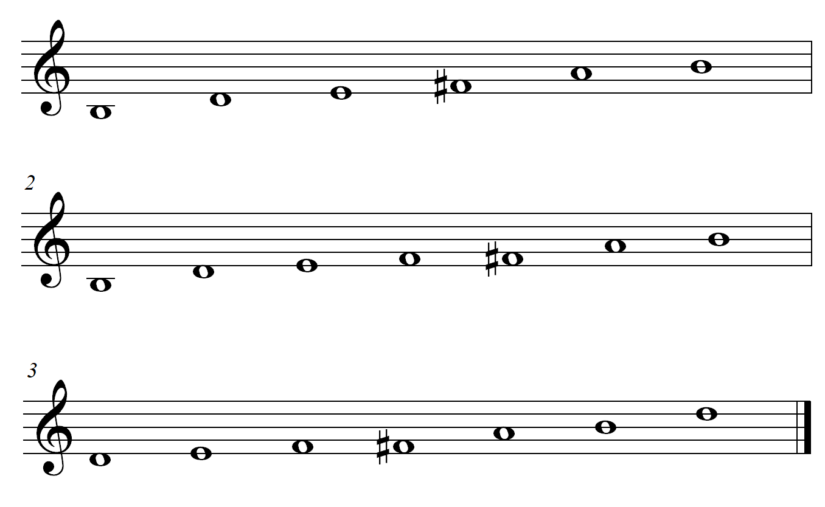
Warm-up
Write a B minor pentatonic scale.
Write a B [minor] blues scale.
Write a D major blues scale.

Slide 16
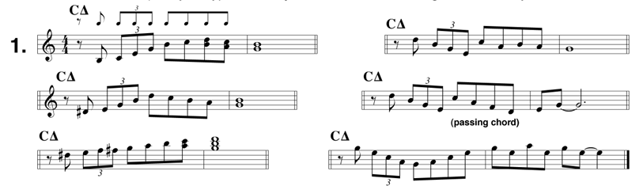
Warm-up
Sing some jazz licks with swung rhythms and on solfege:

Slide 17
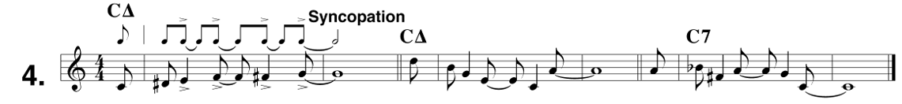
Warm-up
Sing some jazz licks with swung rhythms and on solfege:

Slide 18
Harmony: Chord Symbols

Slide 19
Harmony: Root
The root of the chord is given as an uppercase letter

Slide 20
Harmony: Quality

Slide 21
Harmony: Extensions, Alterations, Etc.
Extensions: “Adding additional thirds on top of the triad. Most commonly refers to ninths, elevenths, or thirteenths rather than sevenths, although sevenths are also extensions.”
Quality & Alterations: Assume default intervals for extensions:
Will use # and b to raise or lower regardless of actual accidentals.
Added Note & Suspensions: If no seventh or extensions are implied but notes beyond the triad are present. (add 6, add 9)
Sus 2, sus 4 are common. Assume sus 4 if all you see is “sus”.
m7 | M9 | P11 | M13

Slide 22
Harmony: Bass Notes
In much of jazz and pop, the bass note is the root of the chord.
Chord symbols are assumed to indicate root position chords unless otherwise indicated. But in performance the lowest note might not always be the root!
If the bass note is not the root, folks will use a slash followed by the letter name of the bass note. This will not always show inversion!
Simple example (chord inversion): C/E means to play a C major triad with an E in the bass.
Complex example (not inversion!): C/F♯ means to play a C major triad over an F♯.

Slide 23
Harmony: Chord Symbols

Slide 24
Practice
Spell the following harmonies.
Ema^{13(#11)}
Bb^{7(#9)}
D⁷sus
F⁶
Am⁶₉
B^{o(MA7)}
Quality & Alterations: Assume default intervals for extensions:
Will use # and b to raise or lower regardless of actual accidentals.
Added Note & Suspensions: If no seventh or extensions are implied but notes beyond the triad are present. (add 6, add 9)
Sus 2, sus 4 are common. Assume sus 4 if all you see is “sus”.
7 =m7 | 9 = M9 | 11 = P11 | 13 = M13

Slide 25
MUS 223 • Literature and Materials of Music II
Now playing: “Livery Stable Blues,” Original Dixieland Jass Band (1917)
Today (Friday, May 8, 2026): Jazz Basics
Warm-up
Harmony
Voicing
Analysis Practice
To do for next time:
Homework #5 is due next Monday.

Slide 26
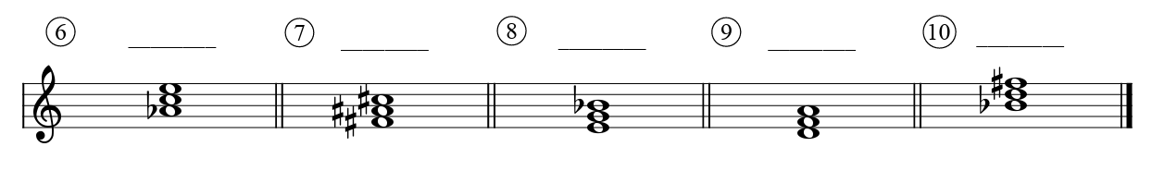
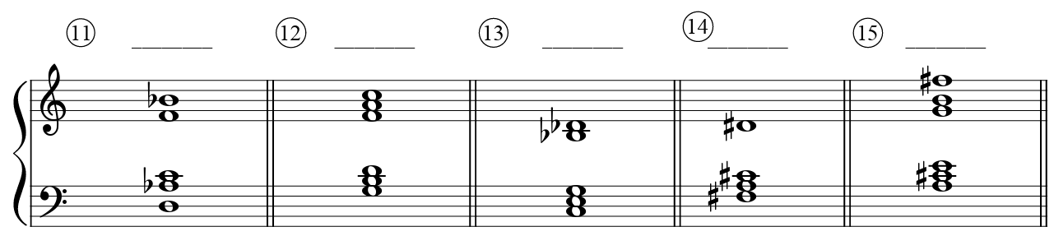
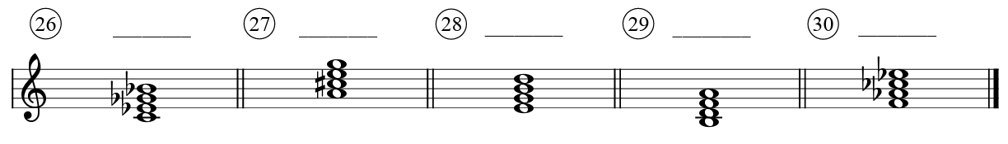
Practice
Write the chord symbol for each harmony above the staff
Quality & Alterations: Assume default intervals for extensions:
Will use # and b to raise or lower regardless of actual accidentals.
Added Note & Suspensions: If no seventh or extensions are implied but notes beyond the triad are present. (add 6, add 9). Sus 2, sus 4 are common. Assume sus 4 if all you see is “sus”.
7 =m7 | 9 = M9 | 11 = P11 | 13 = M13

Slide 27
Harmony: Voicing
Basics of Jazz Voicing (~voice leading in a keyboard style~)
Space chords to mimic the spacing of the harmonic series: use large, wide intervals in lower registers, and smaller, closer intervals in upper registers.
Extensions should be voiced in the higher voices.
If you double a note, usually double either the bass or the root.
You can always get away with omitting the fifth.
Use smooth or “lazy” voice leading: move each voice as little as possible between chords to achieve a smooth, easy-to-perform sound.
A common smooth voice-leading schema in jazz is to lead from the third of one chord to the seventh of the next, while another line connects the ninth of the first chord to the thirteenth of the second chord.
3rd → 7th 9th → 13th

Slide 28
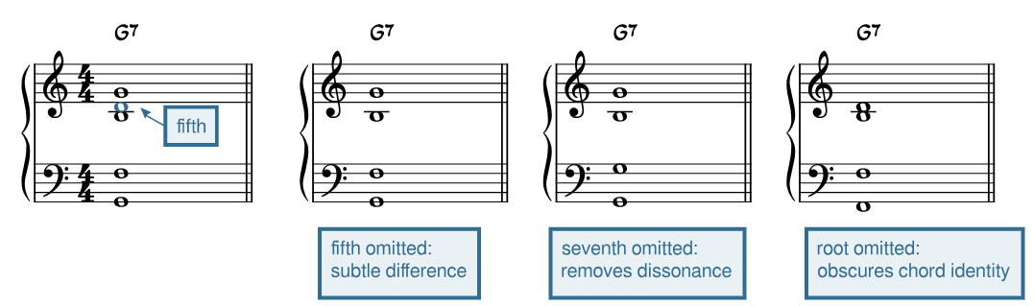
Harmony: Voicing
Basics of Jazz Voicing (~voice leading in a keyboard style~)

Slide 29
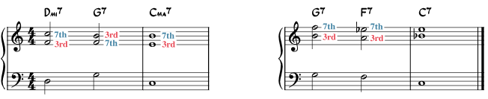
Harmony: Voicing
Jazz Voicing Paradigms (3–7 with extensions)
~2 voices in RH~
If only 3 voices total. It’s important to add extensions. A good trick is to have only the R, 3rd, and 7th of the chord. When roots move by fifth, they can lead into their opposites.

Slide 30
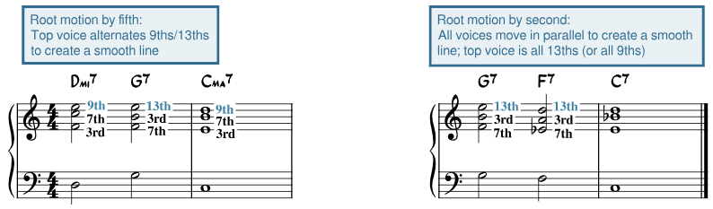
Harmony: Voicing
Jazz Voicing Paradigms (3–7)
~3 voices in RH~
If only 4 voices total. A good trick is to start with the R, 3rd, and 7th of the chord (as before). Now add an extended tone, usually the 9th or the 13th. When roots move by fifth, 9^{ths} will become 13^{ths} and vice versa.

Slide 31
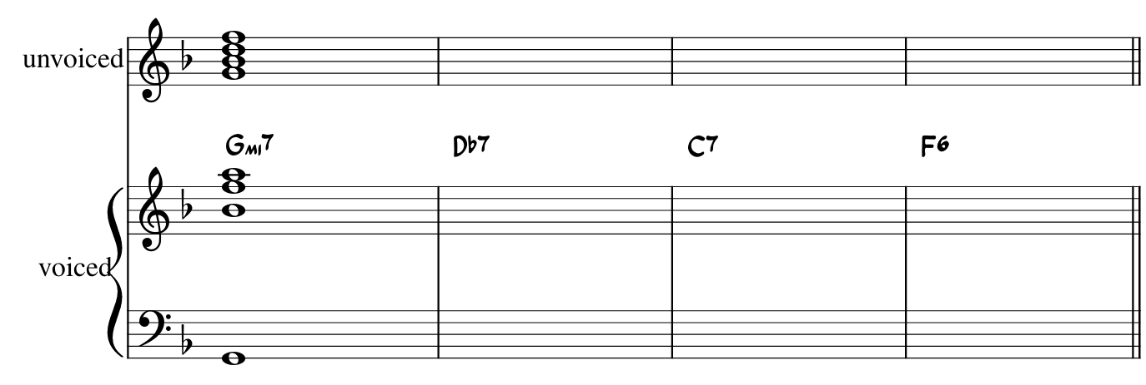
Harmony: Voicing

Slide 32
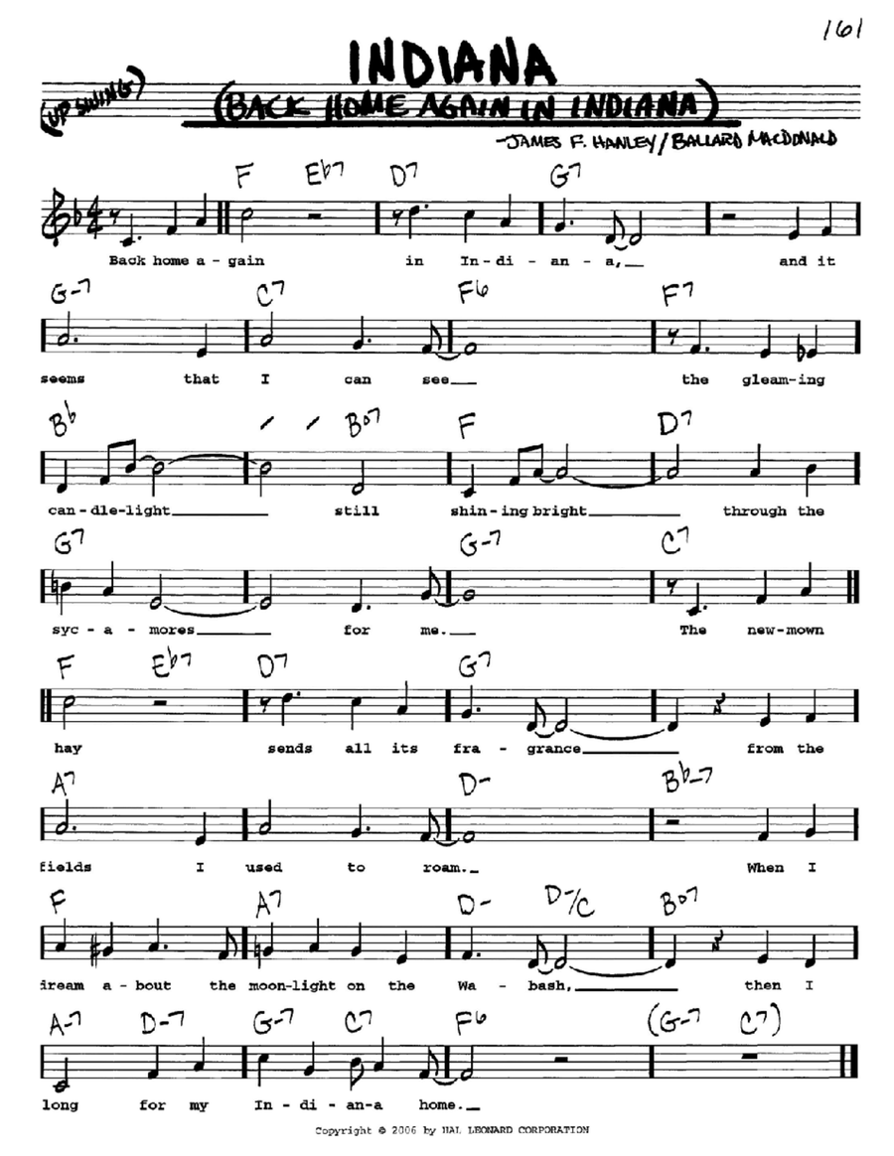
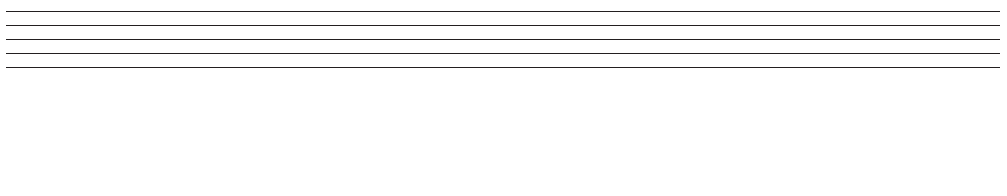
Harmony: Voicing

Slide 33
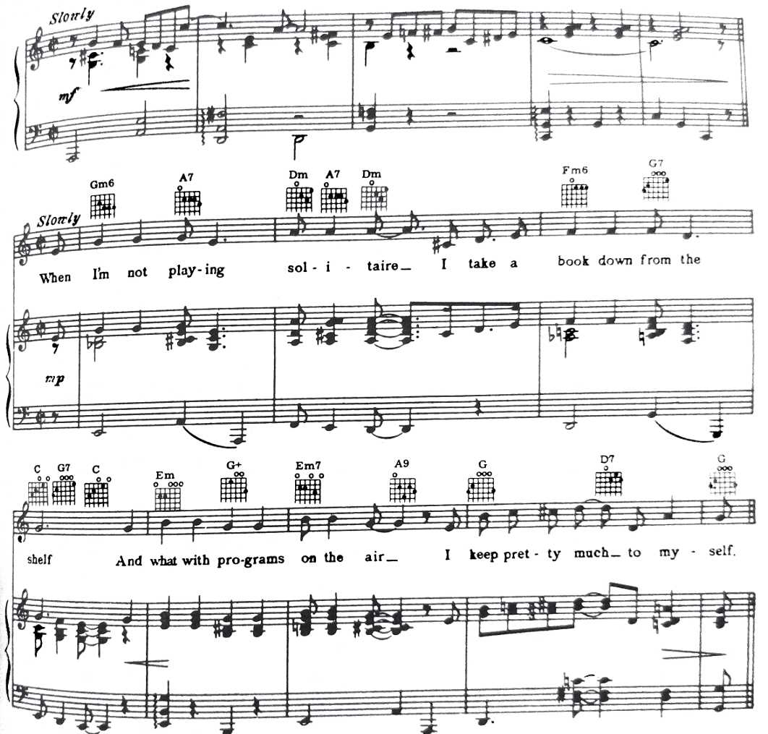
“Don’t Get Around Much Anymore”
Duke Ellington

Slide 34
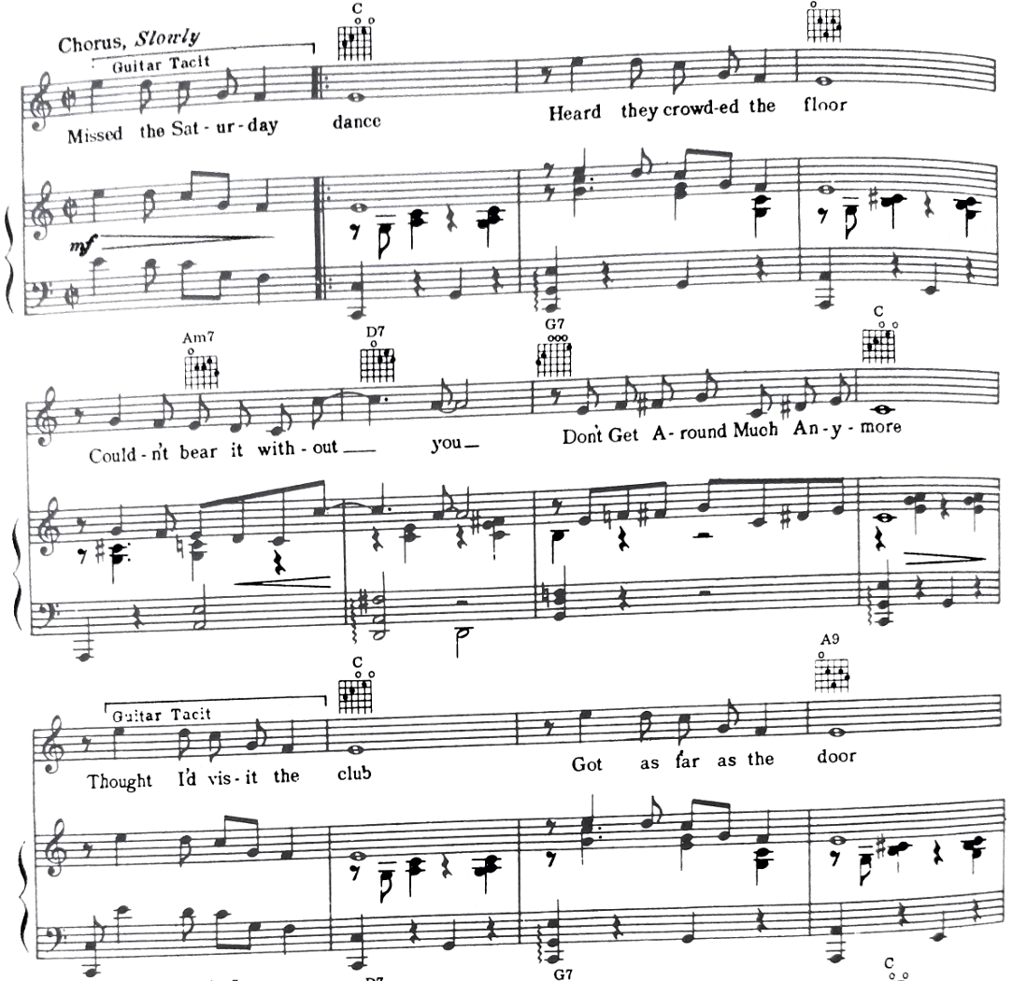
“Don’t Get Around Much Anymore”
Duke Ellington

